Slide 1
Regression Analysis
Multiple Linear Regression
Nicoleta Serban, Ph.D.
Professor
School of Industrial and Systems Engineering
Predicting Demand for Rental Bikes: Prediction, Interpretation

Slide 2

About This Lesson

Slide 3
Prediction
## Read New Data (Test Data)
test=data[-picked,]
test <- test[-c(1,2,9,15,16)]
## Prepare the test data the same as the training data
## Convert the numerical categorical variables to predictors in the test data
test$season = as.factor(test$season)
test$yr = as.factor(test$yr)
test$mnth = as.factor(test$mnth)
test$hr = as.factor(test$hr)
test$holiday = as.factor(test$holiday)
test$weekday = as.factor(test$weekday)
test$weathersit = as.factor(test$weathersit)
## Build a prediction for model1 with the test data
# Specify whether a confidence or prediction interval
pred = predict(model1, test, interval = 'prediction')
Apply similar R code for the other two models.

Slide 4
Prediction (cont’d)
## Read New Data (Test Data)
test=data[-picked,]
test <- test[-c(1,2,9,15,16)]
## Prepare the test data the same as the training data
## Convert the numerical categorical variables to predictors in the test data
test$season = as.factor(test$season)
test$yr = as.factor(test$yr)
test$mnth = as.factor(test$mnth)
test$hr = as.factor(test$hr)
test$holiday = as.factor(test$holiday)
test$weekday = as.factor(test$weekday)
test$weathersit = as.factor(test$weathersit)
## Build a prediction for model1 with the test data
# Specify whether a confidence or prediction interval
pred = predict(model1, test, interval = 'prediction')
Prediction Output
 | Fit | lwr | upr
6 | -104.3303581 | -3.038988e+02 | 95.238132
9 | 239.0013629 | 3.941481e+01 | 438.587917
30 | -82.5358710 | -2.822639e+02 | 117.192193
35 | 58.5579012 | -1.410152e+02 | 258.130976
38 | 22.5421861 | -1.770914e+02 | 222.175777
44 | 102.8402463 | -9.671724e+01 | 302.397729
47 | -40.1522581 | -2.396963e+02 | 159.391774
48 | -69.0241889 | -2.685984e+02 | 130.549996
63 | 334.4570824 | 1.349013e+02 | 534.012852
65 | 176.2306906 | -2.336174e+01 | 375.823119
68 | -31.2412576 | -2.308027e+02 | 168.320195
69 | -45.1215422 | -2.446761e+02 | 154.433034
78 | 69.0246421 | -1.305309e+02 | 268.580201
82 | 99.6552263 | -9.989334e+01 | 299.203794
85 | 176.4458539 | -2.309072e+01 | 375.982429
87 | 289.1456026 | 8.960119e+01 | 488.690014
Apply similar R code for the other two models.

Slide 5
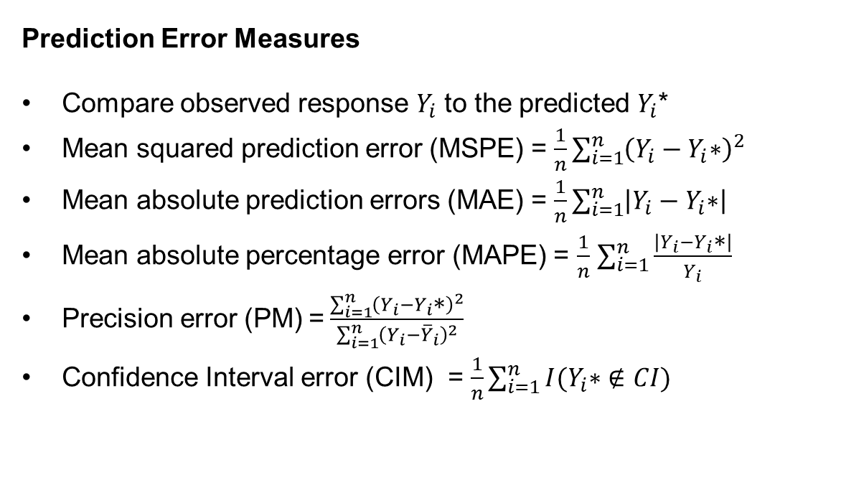
Prediction Accuracy
Prediction Error Measures
Compare observed response $Y_{i}$ to the predicted $Y_{i}$*
Mean squared prediction error (MSPE) = $\frac{1}{n}\sum_{i=1}^{n}{{\left(Y_{i}−Y_{i}\text{∗}\right)}^{2}}$
Mean absolute prediction errors (MAE) = $\frac{1}{n}\sum_{i=1}^{n}{\left|Y_{i}−Y_{i}\text{∗}\right|}$
Mean absolute percentage error (MAPE) = $\frac{1}{n}$ $\sum_{i=1}^{n}{\frac{\left|Y_{i}−Y_{i}\text{∗}\right|}{Y_{i}}}$
Precision error (PM) = $\frac{\sum_{i=1}^{n}{{\left(Y_{i}−Y_{i}\text{∗}\right)}^{2}}}{\sum_{i=1}^{n}{{\left(Y_{i}−{\overline{Y}}_{i}\right)}^{2}}}$
Confidence Interval error (CIM) = $\frac{1}{n}\sum_{i=1}^{n}{I(Y_{i}\text{∗}∉CI)}$

Slide 6
Prediction Error Measure Insights
Mean squared prediction error (MSPE)
Appropriate for linear regression model prediction but depends on scale and it is sensitive to outliers
Mean absolute prediction errors (MAE)
Not appropriate for linear regression model prediction and depends on scale but robust to outliers
Mean absolute percentage error (MAPE)
Not appropriate for linear regression model prediction but it does not depend on scale and robust to outliers
Precision error (PM)
Appropriate for linear regression model and does not depend on scale
Confidence Interval error (CIM)

Slide 7
Prediction Error Measure Insights
Mean squared prediction error (MSPE)
Appropriate for linear regression model prediction but depends on scale and it is sensitive to outliers
Mean absolute prediction errors (MAE)
Not appropriate for linear regression model prediction and depends on scale but robust to outliers
Mean absolute percentage error (MAPE)
Not appropriate for linear regression model prediction but it does not depend on scale and robust to outliers
Precision error (PM)
Appropriate for linear regression model and does not depend on scale
Confidence Interval error (CIM)
While MAE and MAPE are commonly used to evaluate prediction error, I recommend using the precision measure.
-- Regression models are estimated using by minimizing sum of least squares hence the accuracy error shall be best of squared differences not absolute differences

Slide 8
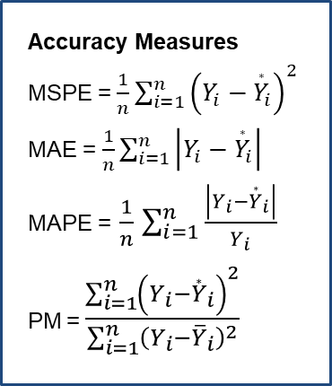
Prediction Accuracy: Model 1
## Save Predictions to compare with observed data
pred1 <- predict(model1, test, interval = 'prediction')
test.pred1 <- pred1[,1]
test.lwr1 <- pred1[,2]
test.upr1 <- pred1[,3]
# Mean Squared Prediction Error (MSPE)
mean((test.pred1-test$cnt)^2)
[1] 10304.95
# Mean Absolute Prediction Error (MAE)
mean(abs(test.pred1-test$cnt))
[1] 74.52024
# Mean Absolute Percentage Error (MAPE)
mean(abs(test.pred1-test$cnt)/test$cnt)
[1] 2.724609
# Precision Measure (PM)
sum((test.pred1-test$cnt)^2)/sum((test$cnt-mean(test$cnt))^2)
[1] 0.3101164
# CI Measure (CIM)
sum(test$cnt<test.lwr1)+sum(test$cnt>test.upr1)/nrow(test)
[1] 0.06904488
Accuracy Measures
MSPE = $\frac{1}{n}\sum_{i=1}^{n}{{\left(Y_{i}−{\overset{∗}{Y}}_{i}\right)}^{2}}$
MAE = $\frac{1}{n}\sum_{i=1}^{n}{\left|Y_{i}−{\overset{∗}{Y}}_{i}\right|}$
MAPE = $\frac{1}{n}$ $\sum_{i=1}^{n}{\frac{\left|Y_{i}−{\overset{∗}{Y}}_{i}\right|}{Y_{i}}}$
PM = $\frac{\sum_{i=1}^{n}{{\left(Y_{i}−{\overset{∗}{Y}}_{i}\right)}^{2}}}{\sum_{i=1}^{n}{{\left(Y_{i}−{\overline{Y}}_{i}\right)}^{2}}}$
Prediction Accuracy
MSPE = 10304
MAE = 74.52
MAPE = 2.72
PM = 0.31
CIM = 0.069

Slide 9
Prediction Accuracy: Model 3
## Save Predictions to compare with observed data
pred3 <- predict(model3, test_red, interval = 'prediction')
test.pred3 <- pred3[,1]^2
test.lwr3 <- pred3[,2]
test.upr3 <- pred3[,3]
# Mean Squared Prediction Error (MSPE)
mean((test.pred3-test$cnt)^2)
[1] 11271.78
# Mean Absolute Prediction Error (MAE)
mean(abs(test.pred3-test$cnt))
[1] 78.67701
# Mean Absolute Percentage Error (MAPE)
mean(abs(test.pred3-test$cnt)/test$cnt)
[1] 0.5172032
# Precision Measure (PM)
sum((test.pred3-test$cnt)^2)/sum((test$cnt-mean(test$cnt))^2)
[1] 0.316168
# CI Measure (CIM)
sum(test$cnt<test.lwr3)+sum(test$cnt>test.upr3)/nrow(test)
[1] 0.060984
Prediction Accuracy
MSPE = 11271
MAE = 78.67
MAPE = 0.517
PM = 0.361
CIM = 0.061

Slide 10
Model Comparison
Model | MSPE | Precision.Measure | Adjusted.R.Squared | R squared
Full MLR | 10304.95 | 0.310 | 0.684 | 0.685
MLR (sqrt transformation) | 8955.41 | 0.271 | 0.784 | 0.785
MLR (sqrt transformation-no low demand data) | 11271.78 | 0.362 | 0.656 | 0.658
The model with the square-root transformation outperforms the other models in terms of predictive power as reflected in the Precision Measure and R squared.
The constant variance assumption is violated across all models.

Slide 11

Summary

